Slide 1
Rogelio Macedo – Internship Summary Rapid automation – analysis for developers (RAAD)

Slide 2






Today’s Promise
A general understanding of how today’s contributions will empower tomorrow’s success.
Integrating into Intel’s Rapid Automated-Analysis for Developers (RAAD) Team
RAAD OneShot API and Demo Contributions
Jira Autolabeling: revealing complex interconnections and root-cause suggestions from a growing history of Jiras
Additional Contributions and Completions
Notes:
After these next 60 minutes, you will gain a general understanding of my internship experience, how this exper. has positively impact me, and how it might impact you and others around the world. Today’s agenda will cover the following milestones.

Slide 3
Special RECOGNITIONS
Intern Mentor:
Joe Tarango,
Manager:
Jim Baca,
GM:
Previously
Sanjeev Trika, currently Prasanna Rupasinghe
Teammates:
Daniel Garces, Tyler Woods, PanteA Zardoshti
Stella Cao,
Sungkeun Kim
,
Notes:
A big thanks to all the amazing teammates I have has throughout this last year, we really built a great support system and inspired one another along the way.
Thank you for your inspiring leadership, ability in productizing a vision, and exemplary mentorship as a professional engineer and individual. Your guidance on building the fault root-cause suggestion system which has recently been integrated into RAAD was essential, and I am proud to have worked on your team and at Intel this last year.
I have had an unparalleled amount of fun working here and have grown so much as a computer scientist and as a human being. As much as I was a part of intel this past year, intel will now always be a part of me!

Slide 4






About ME
Rogelio Macedo
Notes:
BS Computer Science graduate at UC-Riverside (March 2020)
MS student at UC-Riverside about to defend thesis around the first week of September 2021
My focus is on computer-aided design for microfluidic laboratories-on-a-chip which has positively impacted biochemical applications at the global scale.
Specifically contributing to a design and verification framework centered on continuous fluid flow microfluidics
Interests:
spending quality time with Family
practicing mental and physical wellbeing through exercise, stretch and recovery sessions, meditation, reading,
I am a firm believer that life never stops teaching, so never stop learning, and am deeply passionate in soliciting a better tomorrow through building great technology

Slide 5






Milestone: Ramping up for RAAD
Culture Attributes
fearless
inclusion
customer
obsessed
one intel
truth &
transparency
quality
Notes:
At the start of the experience Intel had me participate in the NEO presentation, which quickly set the expectations regarding Intel’s purpose, vision and values. This was immediately one of the first things that stood out to me and helped set the pace moving forward. I also had the opportunity to participate in Intel’s Quality culture training course, as well as in many other instances and online training. I am proud and honored to have been so well-received by Intel’s online culture and atmosphere, and I will gracefully pass on these values everywhere I go.

Slide 6
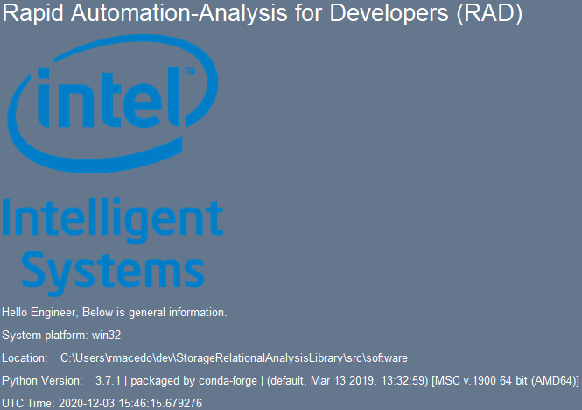



Milestone: Ramping up for RAAD
Same RAAD Tool, Simplified Interface
OneShotAPI v1 (Tyler, Rogelio)
GUI addition to initiate capture of telemetry and system metadata
Time-series extraction, parse, machine programming engine analysis, store/extract in Axon, generate expert report
Perform entire process with a single click
Notes:
First tasks as an intern: OneShotAPI

Slide 7
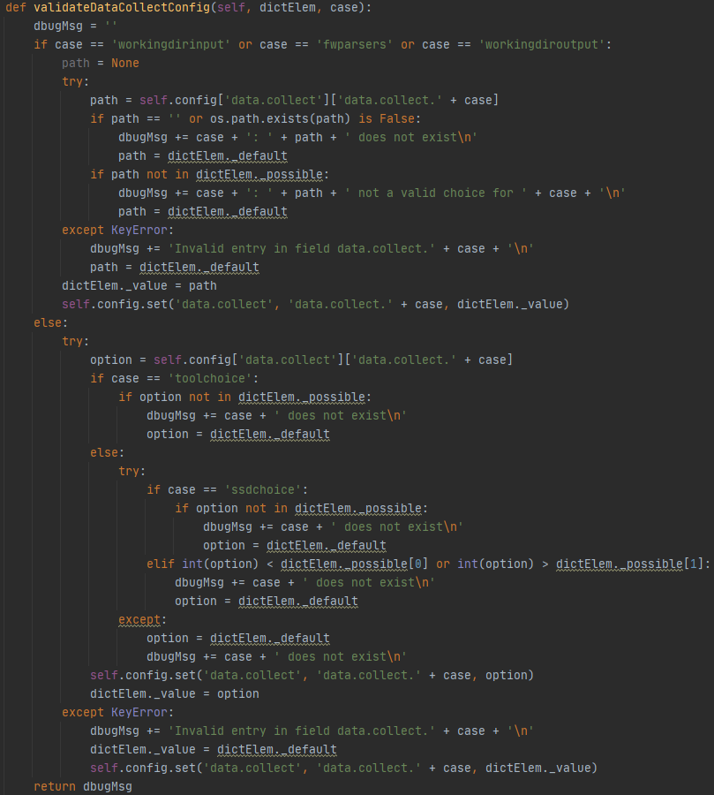
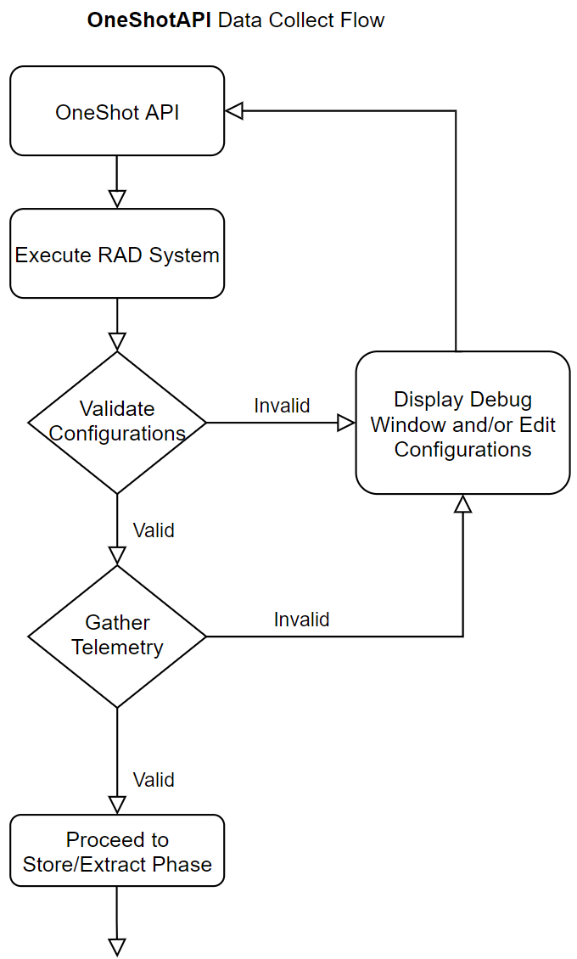
Input Validation
Verifying that the input passed to the framework will produce feasible results

Slide 8
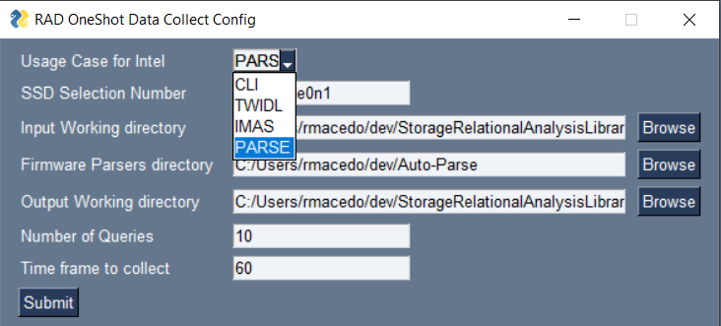
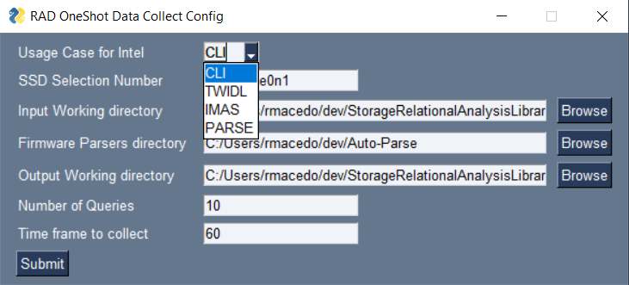
Milestone: Ramping up for RAAD
Screenshots of Data Collection Phase Configuration
PARSE Pre-existing Telemetry
NVMe-cli for Fresh Telemetry Pulls
Notes:
Allows you to slecet bw options

Slide 9
Milestone 1: Ramping up for RAAD
Notes:
In order to show the ease of use, created something called one shot that can perform entire flow
Capture: Access Meta through automation in collection
RAAD_Pool drives set up in ConVal sandbox [Daniel, Joe]
Precondition SSD with IOMeter and FIO workload
Periodic Pull of Host Initiated Telemetry (HIT) [Daniel, Joe]
ML Auto Tuning of Data Pull Frequency, pre-process, and time series
Inject Test Command Errors for Controlled Experiments
Telemetry and Media Meta Collection Scripts [DND–Josh Yang, Daniel, Joe]
Collect System Meta Data [Tyler, Daniel, Joe, DND-Amir]
Collect Data thru NVMe ID Controller, CLI, and IMAS to assemble meta data
The System Data Captured (shown in box to the right)
Capture includes ConVal, PV, RDT Customer, etc.
Store/Extract: Use Axon to store output of RAAD execution
Parse Use the autoparse lib to extract telemetry content into desirable formats
Parse Telemetry Binary (CFE-Phuong and Joe)
New compiler features (similarity search and verified lifting of meta data)
Python 2.x and 3.x compatible
All data objects can be parsed
Also includes Nlog parsing (Daniel)
Time Series Visualization (Daniel)
Preconfigured / Dynamic Guided Graph Generation
Data Management Linkage (Joe/Daniel)
Developed a time series file format
Data Aggregation into OneAPI (Joe/Daniel)
Transform the file format into TensorFlow objects, as well as CVS
Debug Handbook Wiki Web-Crawling
Crawl the associated Debug Handbook Wiki based on the assert extracted from telemetry
Analyze: use engines to perform tasks on analysis
Machine Learning Algorithms (Joe and IL-Justin)
Using data mining techniques to feed the search and match algos
MPR research code fork now part of RAAD Repo (MISIM, AutoPerf, ControlFlag)
Data mine, classify, label, train, speculate deterministic data
Utilize data from source code databases (Github) and Atlassian databases (Jira)
Report
Generate latex code
Save metadata locally
Compress data for storage

Slide 10
Milestone: RAAD PF Demo
Demonstration of OneShot API gathering and processing fresh-pulled telemetry
Demo Link
Notes:
Main goal was to Simpify the entire process end to end
We want to make it easy for the fw to start the process we have this simplified interface Automatic and adjustable configurations
The use of the RAAD tool bundles all of the output, diagrams, reports into a single location

Slide 11











Milestone: JIRA Autolabeling
Fault UUID
Mine/Clean/Store
Analyze
Learn From The Past
Fault’s Known Causes
Thank you to Joe for helping with this project proposal and enabling the extension of the Internship! ☺
Notes:
As far as the debugging process, the target for automation here is in the manual searching, filtering, and sorting of existing Jiras relevant to some assert signature. A data mining pipeline that uses an assert unique signature with its set of known causes to dig through and collect the history of Jira related to the assert, and groups those Jiras by a speculated known cause. Given any new Jira tagged with the same assert signature, we can determine where it lands among the search space of known and labeled Jiras, and quicky provide a roadmap for the
given rich database in form of JIRAs, show how we gonna take that info and make it useful for the RAAD system
developer to begin their Jira investigation. Further automating the debugging process brings value to Intel and our customers.

Slide 12
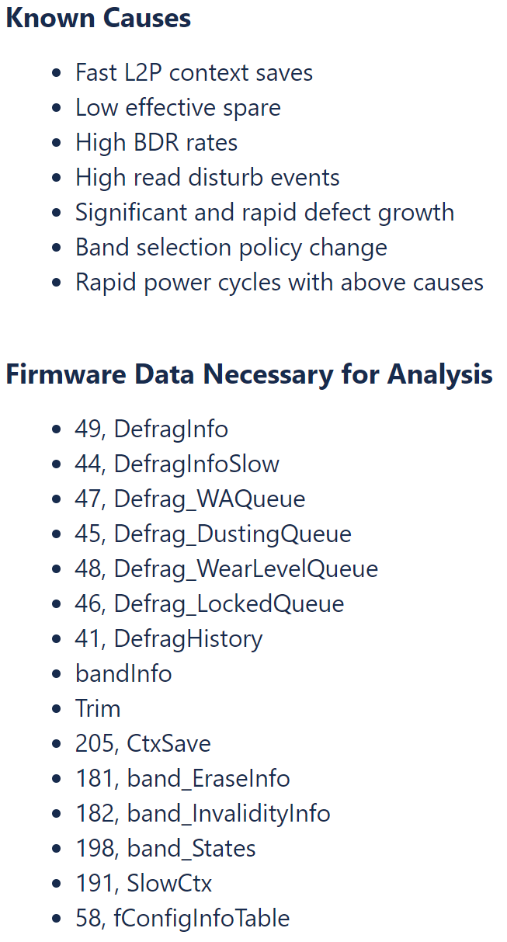
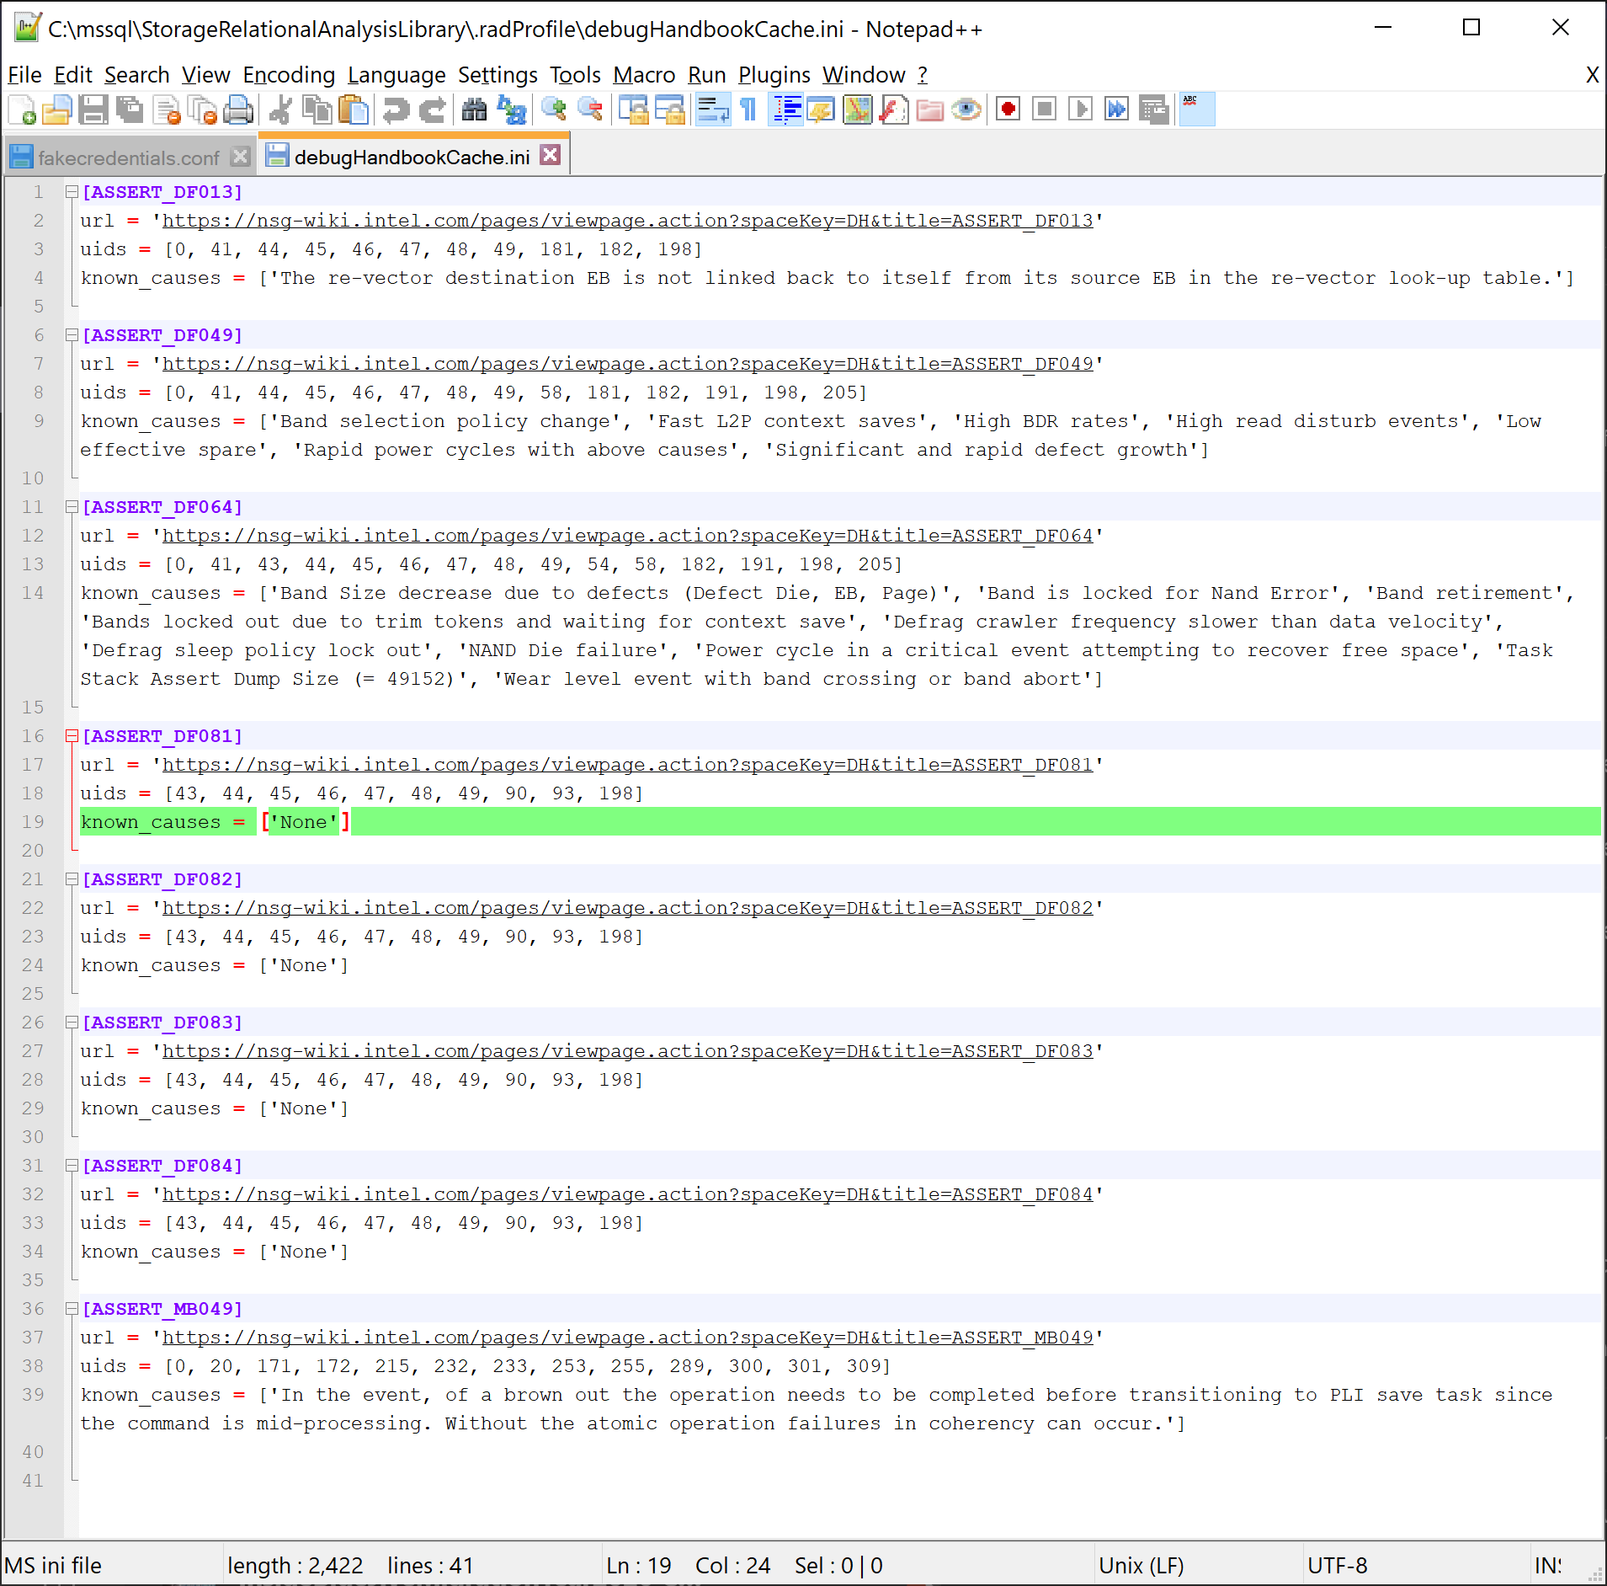
codified Debug HAndbook Crawled data used as input
Debug Handbook wiki
(DF - Defrag Asserts)
Codified handbook (DF049)
Codified handbook (MB049)
Codified Debug Handbook info (Joe and Amir)
DF049 - The failure is a result of a long-term algorithmic issue with our core algorithms for band selection and data relocation.
Notes:
Input shown here is the set of known causes for the assert that is extracted from telemetry

Slide 13
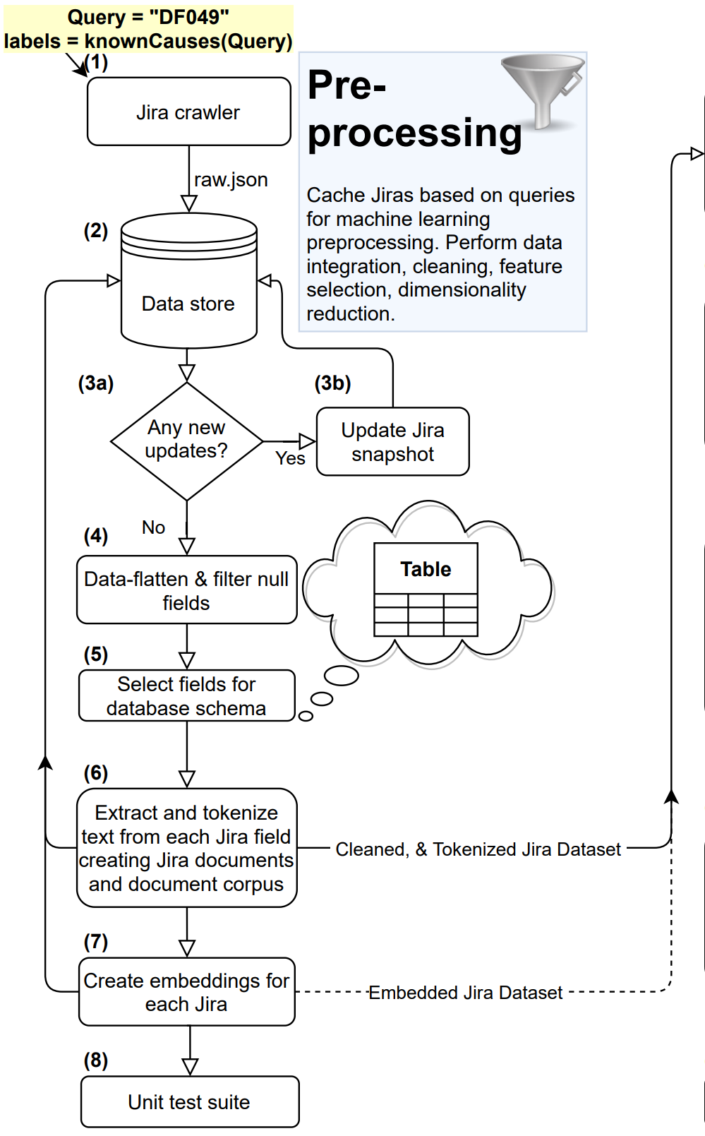
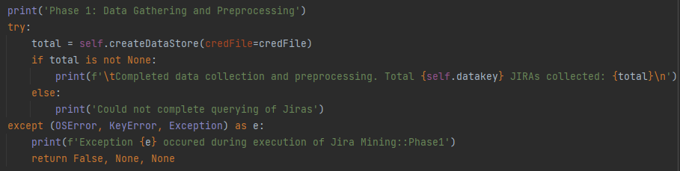
Milestone Cont.
Phase 1: Data Preprocessing
Objective: Query, cache, clean, and transform raw Jira data from nsg-jira.intel.com
Inputs:
Assert signature extracted from telemetry
Set of known root causes specific to the assert
Outputs:
Cleaned and tokenized datasets
Embedded/vectorized versions of dataset
Notes:
What does it mean to clean?

Slide 14
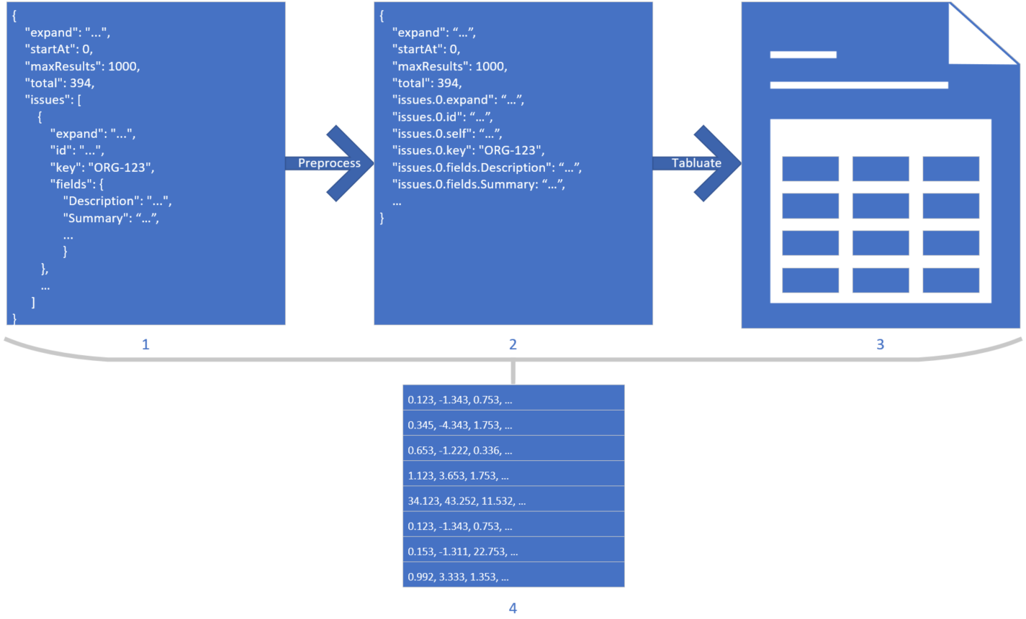
Milestone Cont.
Phase 1: Data Preprocessing Flow
Notes:
Transformation of text data. (1) Raw crawled JSON data, (2) flattened JSON into a single level object, (3) tabular representation of a data instance per row, (4) and a numerically embedded representation of a data instance per row. Data values are mocked for visual clarity.

Slide 15
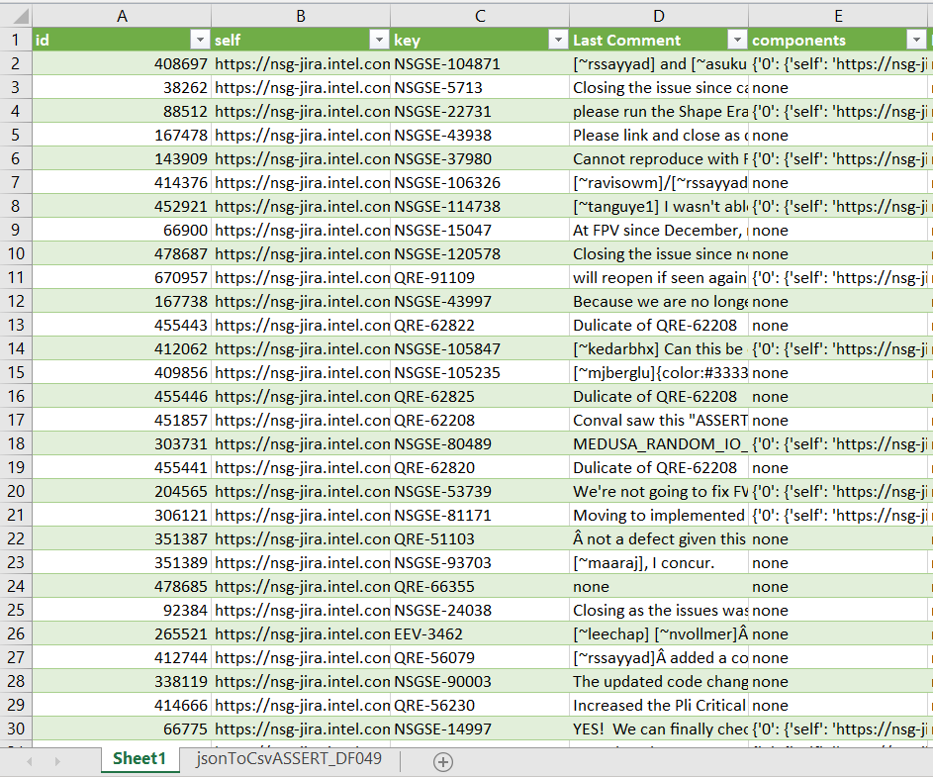
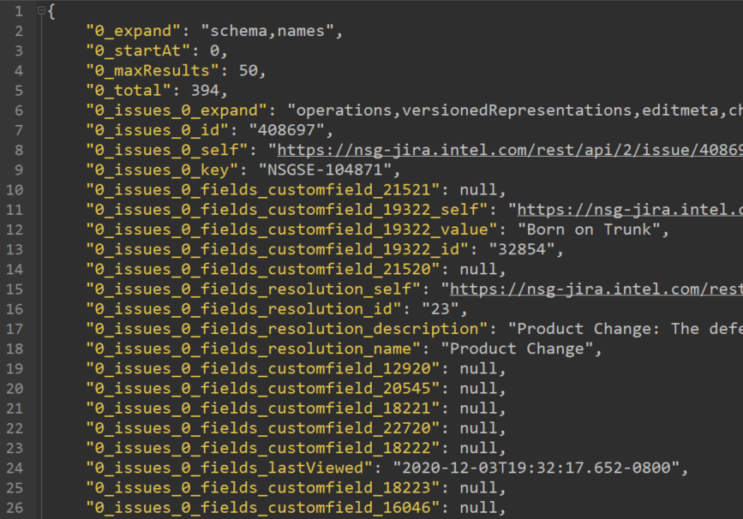
Preliminary Results: Data Processing
Collected/Cleaned ~400 JIRAs pertinent to DF049

Slide 16
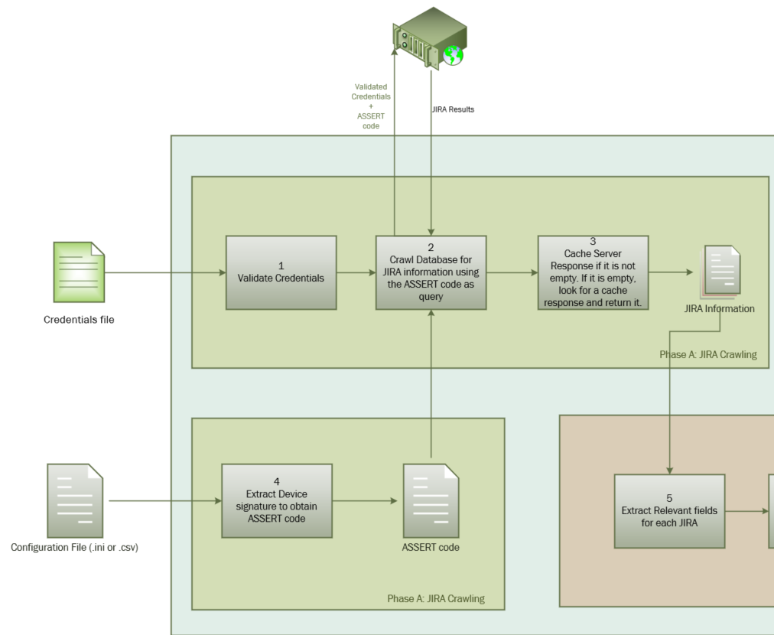
Notes:
Implemented Technical Design Flow

Slide 17
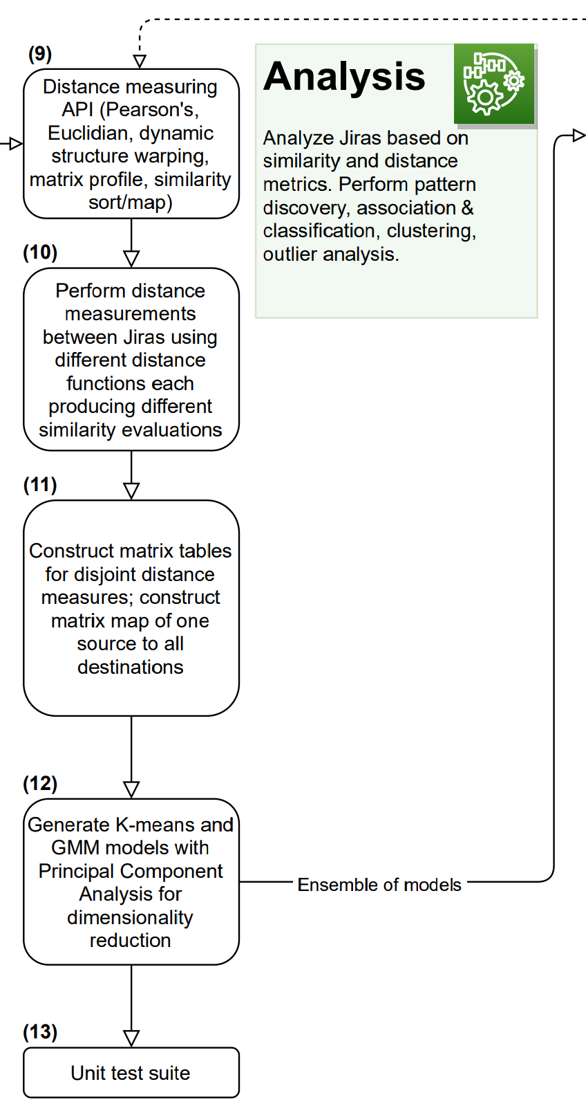
Milestone Cont.
Phase 2: Machine Learning Analysis
Objective: Apply data-driven unsupervised learning techniques to automatically separate Jiras into individual groups based on similarity relationships
Inputs:
Human-readable dataset of Jiras
Matrix of embedded/vectorized Jiras
Outputs:
Distance matrix between all Jiras based on desired distance metric
K-Means clustering model
Gaussian-Mixture-Model clustering
Notes:
The key is that we are tying distance to the notion of similarity. We explicitly judge two records with a high distance value as not similar, and two records with low distance value as similar.
Application of scientific method to create proof of concept using TF-IDF vectorization to generate results to using full on pre-trained models to emebed Jiras and pass on to model generation. Similar approach was taken when initially starting with Kmeans model and then improving with the generatrive model known as Gaussian Mixture Models, which accounts for covariance within data, and is based on the central limit theorm regarding the assumption that datapoints are composed or generated by a mixture of Gaussians or std dist.

Slide 18
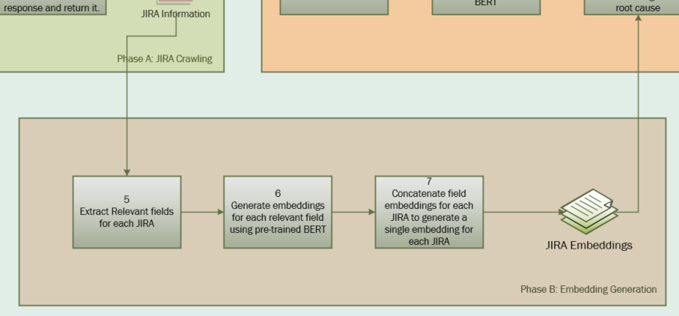
Notes:
Implemented Technical Design Flow

Slide 19
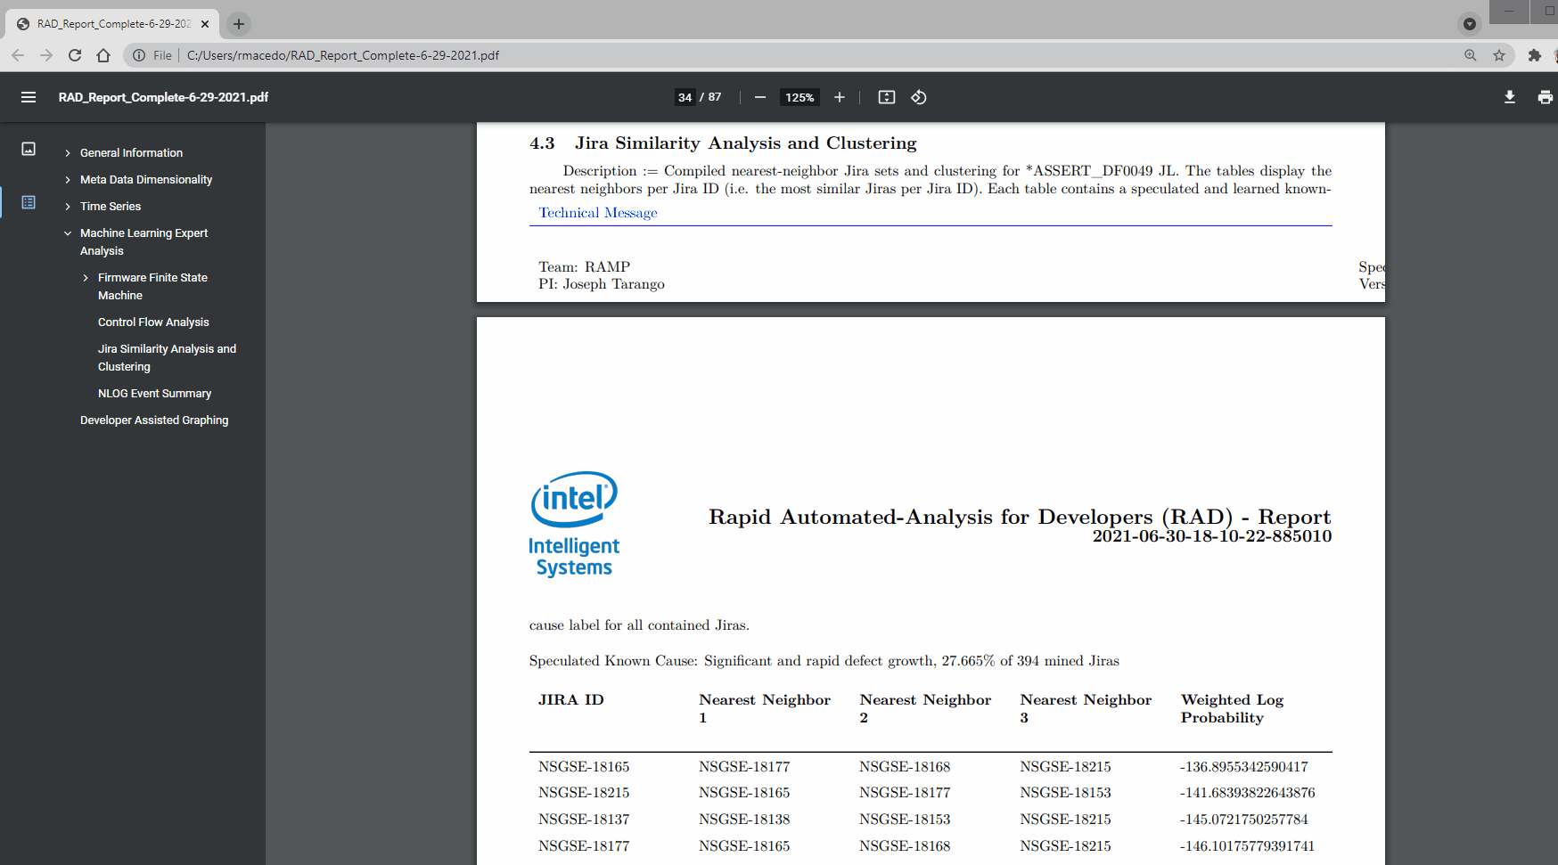
Notes:
Screen recording gif of Jira section of report showing the nearest neighbors of jira, and clicking on each link showing usage flow
Compiled nearest-neighbor Jira sets and clustering for *ASSERT_DF0049 JL. The tables display the nearest neighbors per Jira ID (i.e. the most similar Jiras per Jira ID). Each table contains a speculated and learned knowncause label for all contained Jiras, and an associated probability of the speculation

Slide 20
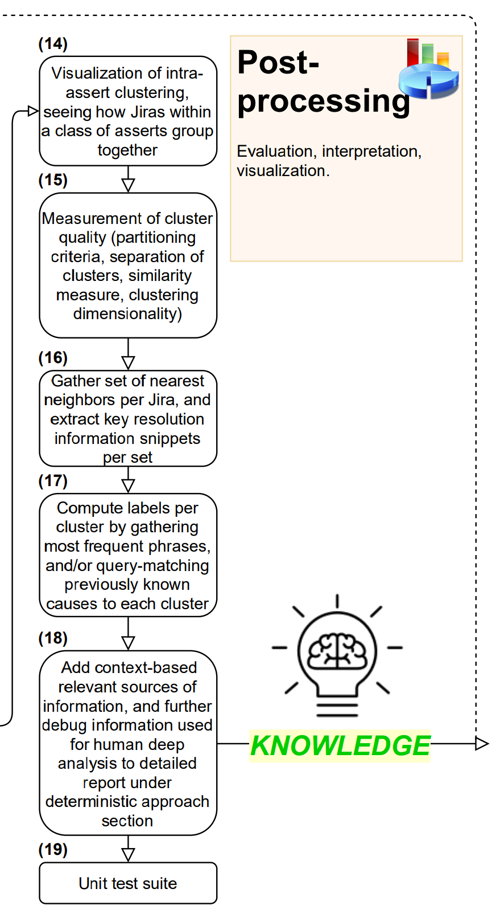
Milestone Cont.
Phase 3: Visualization and Model Evaluation
Objective: Provide visualization of Jira groups/clusters for the developer, and assign a cluster to a speculated known root-cause
Inputs:
Ensemble of clustering models (e.g. K-Means, GMM)
Set of known root causes specific to the assert
Outputs:
3D Cluster graphs
Clustering evaluation
Assignment of known root-causes to clusters of Jiras

Slide 21
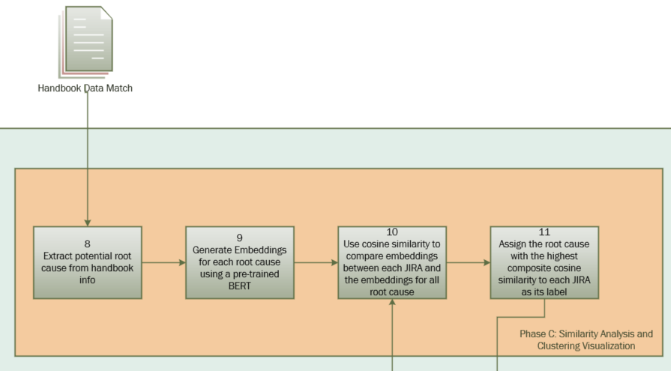
Notes:
Implemented Technical Design Flow pt 1

Slide 22
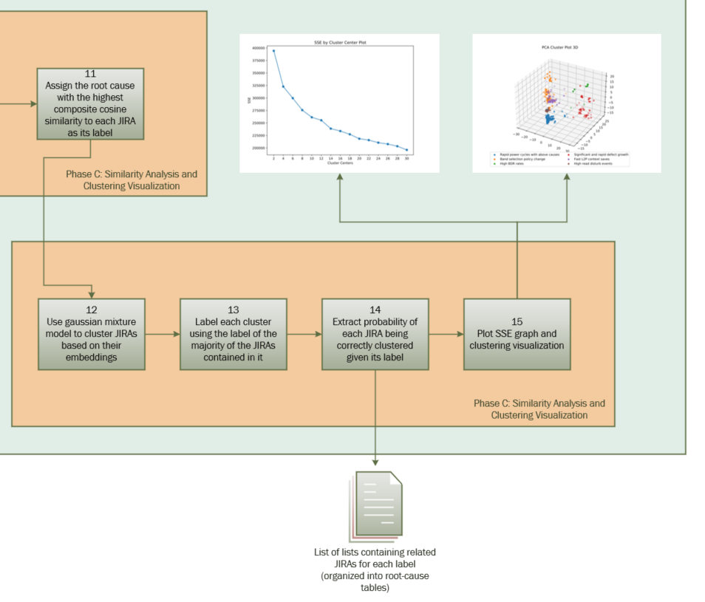
Notes:
Implemented Technical Design Flow
THE NEXT SLIDE MAY CAUSE VERTIGO

Slide 23
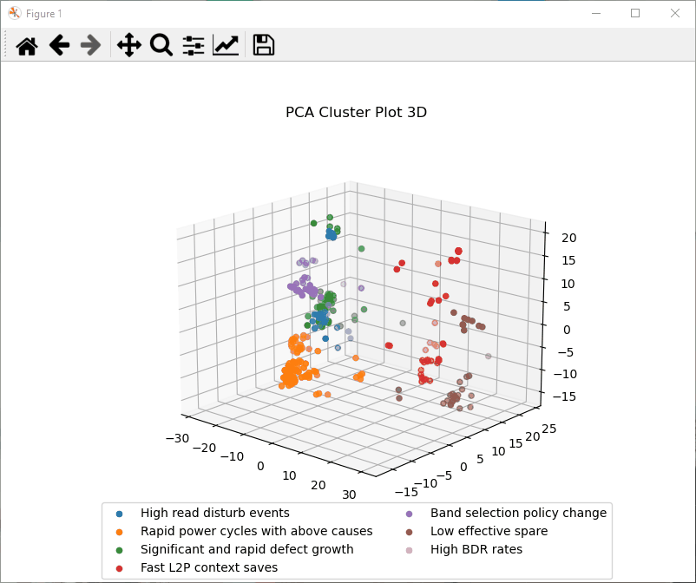
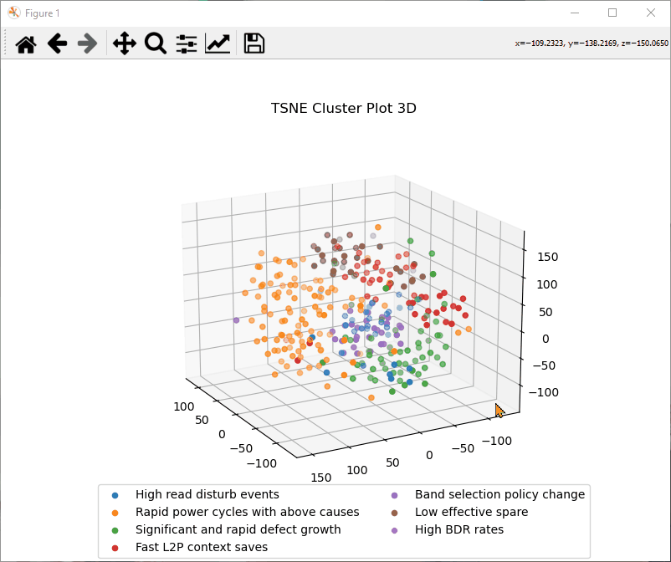
Milestone Cont.
Phase 3: Visualization
Notes:
Gifs of rotating cluster graphs

Slide 24
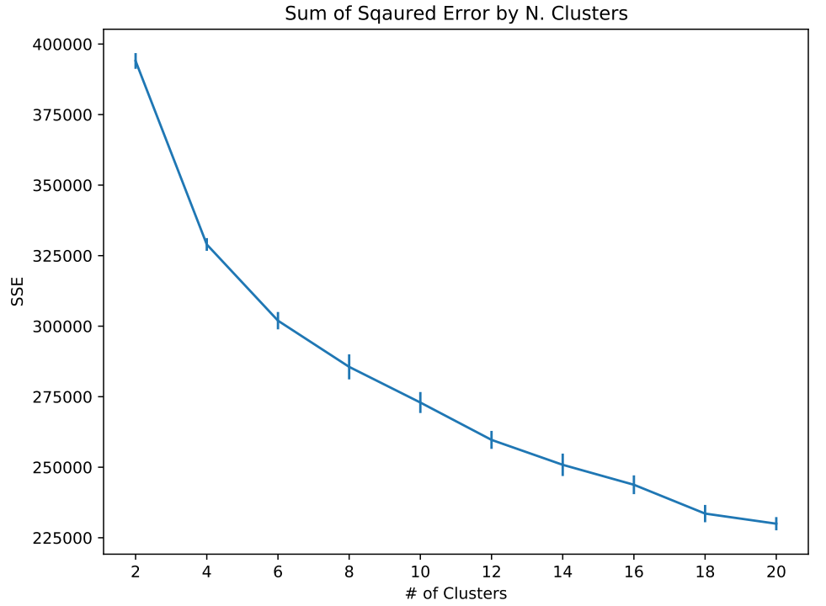
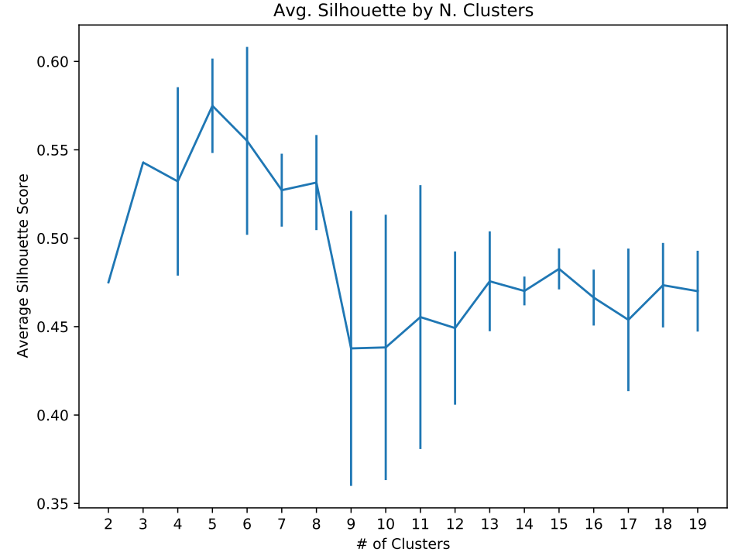
Milestone Cont.
Phase 3: Model Evaluation
Notes:
System also generates series of error-bar curve plots which evaluate the clustering quality. The vertical bars seen on the curve plots are representing the error or standard deviation found after training a clustering 20 times and taking the average of a particular metric.
For each potential number of clusters k from 2 to 20, run the clustering 20 times and average the following: SSE: Sum of squared error/difference (SSE) between each node and the mean of the cluster it belongs/closest to. It can be used as a measure of variation within a cluster, and describes the average distance between each node in a cluster to it’s centroid (the center of mass of the cluster). Pick the value k right after the steepest slope in the curve (we want a high density within a cluster meaning the cluster is tightly packed)
Silhouette Score: This corresponds to average distance between a node within a cluster and all other nodes in the same cluster, and the average distance between a node in one cluster and all other nodes in the next nearest cluster (measure how much a point is similar to its own cluster compared to other clusters; we want high separation between clusters; distance can be measured in different ways). Pick the k with the highest average score

Slide 25
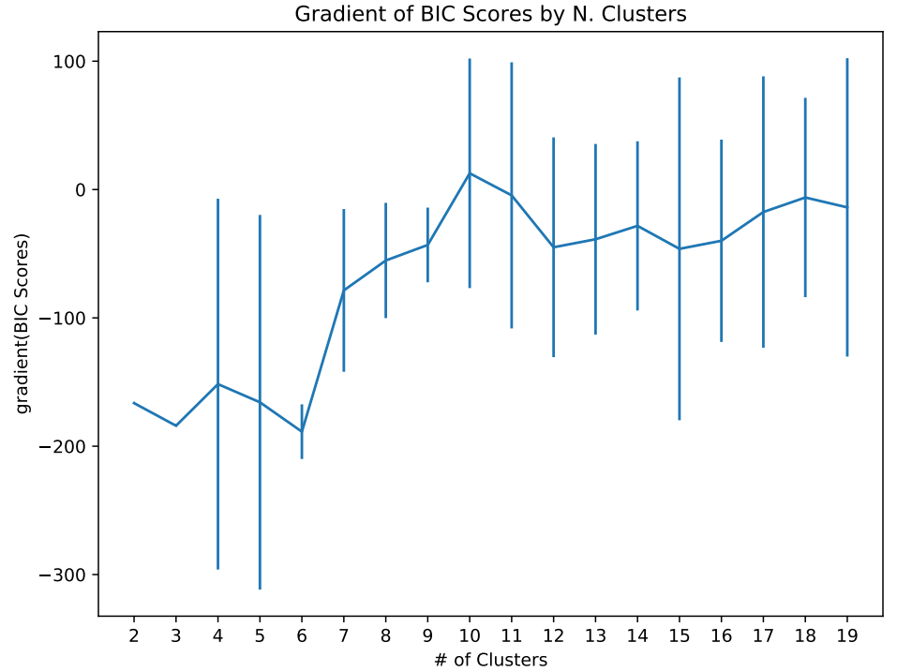
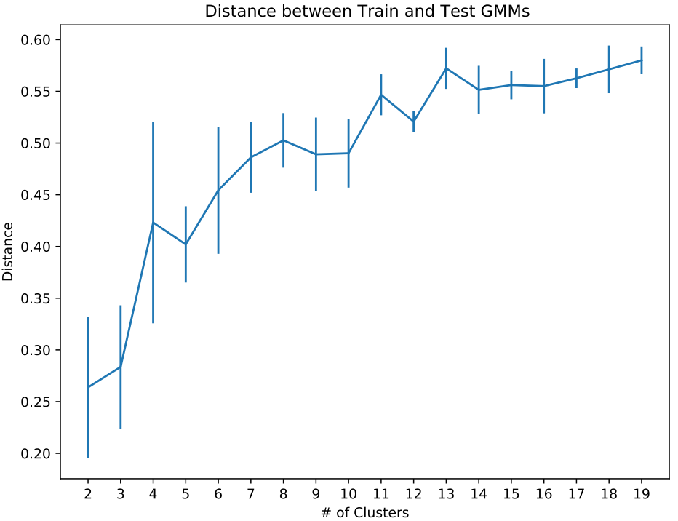
Milestone Cont.
Phase 3: Model Evaluation
Notes:
Gradient of BIC: Bayesian-Information Criterion (BIC) gives us an estimation on how good the GMM is in terms of predicting the data we have. The lower the BIC, the better the model is at predicting our distribution of data. To avoid overfitting, this technique penalizes models with a large number of clusters. However, this does not benefit complex distributions of data that might have many clusters. Thus, the penalty the BIC criterion gives to complex models do not save us from overfitting. Usually, this score has smooth curve and can be seen to have level-sloped sections. Thus, this leads us to check the gradient of this curve as a better approach for the evaluation. The magnitude of the gradient tells us how much the two values are different. Pick the value k where the slope is equal to zero on average afterwards, or the first value k where the slope of the gradient suddenly changes from very steep upward slope to a more gentle upward slope
Distance (Jensen-Shannon) between two Gaussian Mixture Models (GMMs): Checks how much the GMMs trained on the two sets are similar, for each configuration of value k. The smaller is the JS-distance between the two GMMs, the more the GMMs agree on how to fit the data. This is focusing mainly on the reproducibility of the results between the two datasets. Pick the value k with the first largest sudden increase in distance, or the value k immediately after.

Slide 26
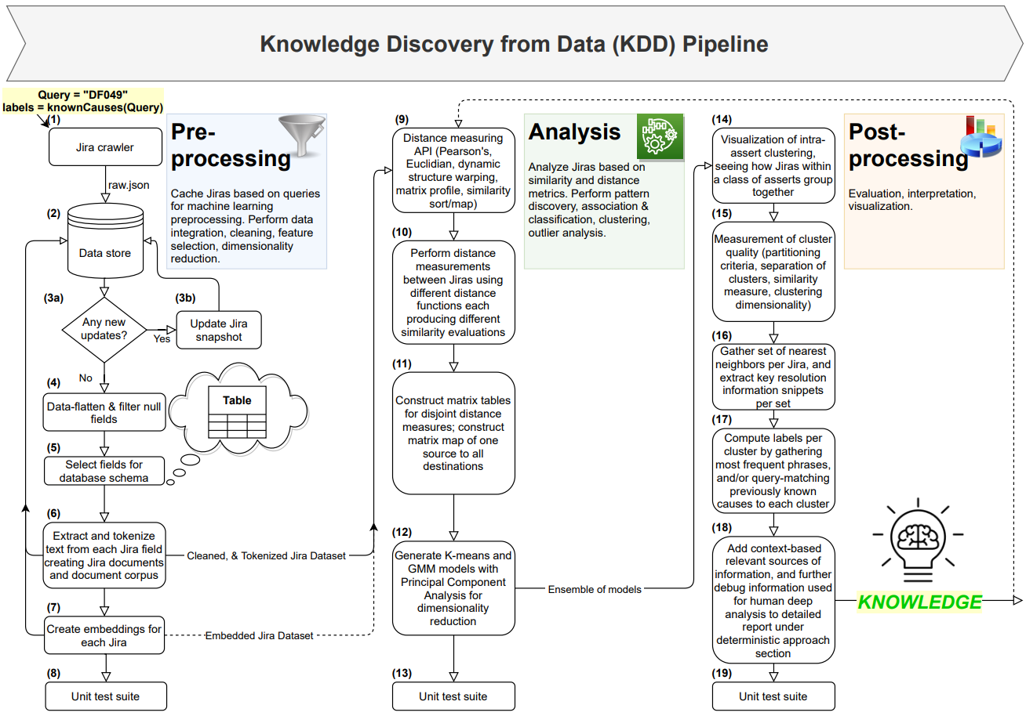
Jira Mining Flow
Notes:
Three phases to a KDD

Slide 27
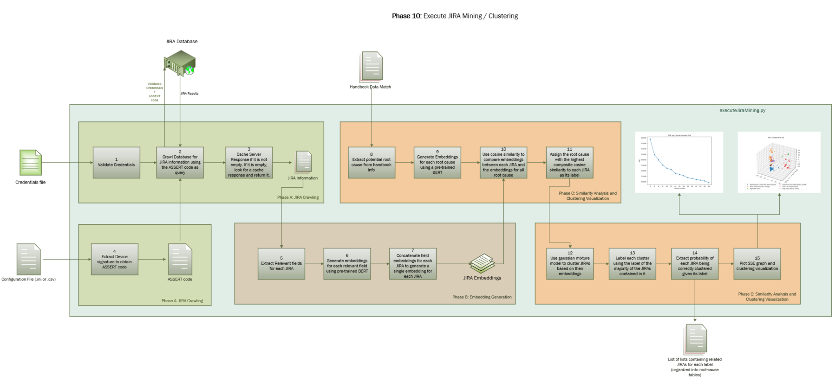
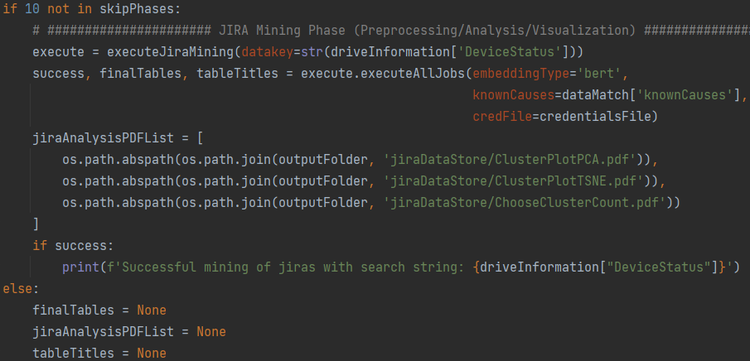
Notes:
Implemented Technical Design Flow

Slide 28
Additional Contributions
Completed Related Tasks
IDF Submission for Jira Autolabeling (Huge thanks to Jim for the guidance ☺)
Script to convert JIRA custom field mappings
Preprocessing API within RAAD (Collaborated with Daniel)
Creation of Agile/Scrum Weekly Update Template (Content developed by Joe)
How-to Wiki to Setup RAAD to Work Overnight

Slide 29
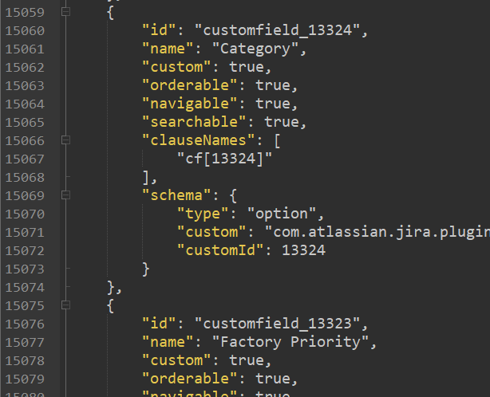
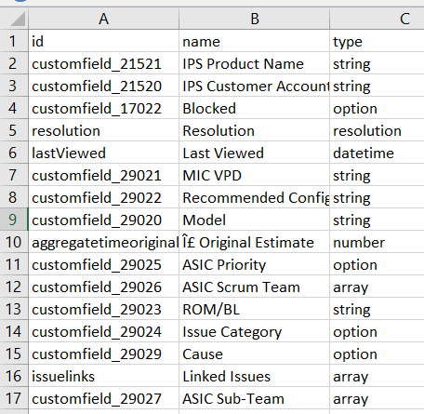
Additional Contributions Cont.
Phase 1 Auxiliary Step: Custom Field Mapping
Problem: “customfield_18223” is not a meaningful field title…
Utilize Jira field-descriptions to create mapping
Notes:
Challenges of applying meaning to each and every custom jira field. Mapping had to be established
Script that can perform get request to get jira field descriptions json

Slide 30
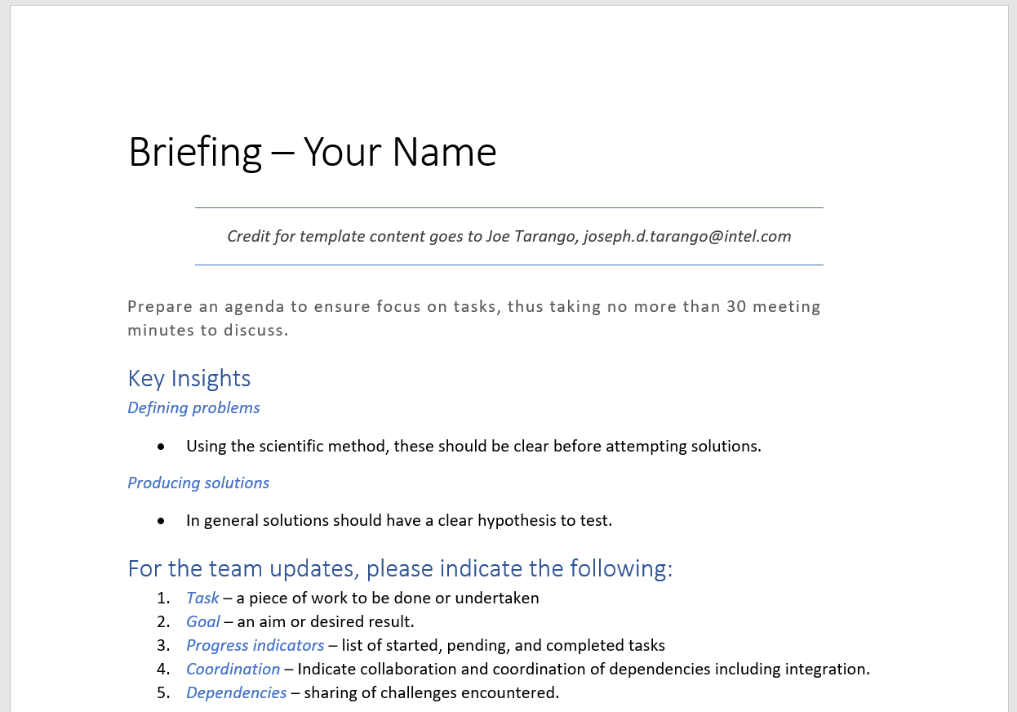
Additional Contributions Cont.
Agile/Scrum Weekly Update Template (Content developed by Joe)
Link

Slide 31
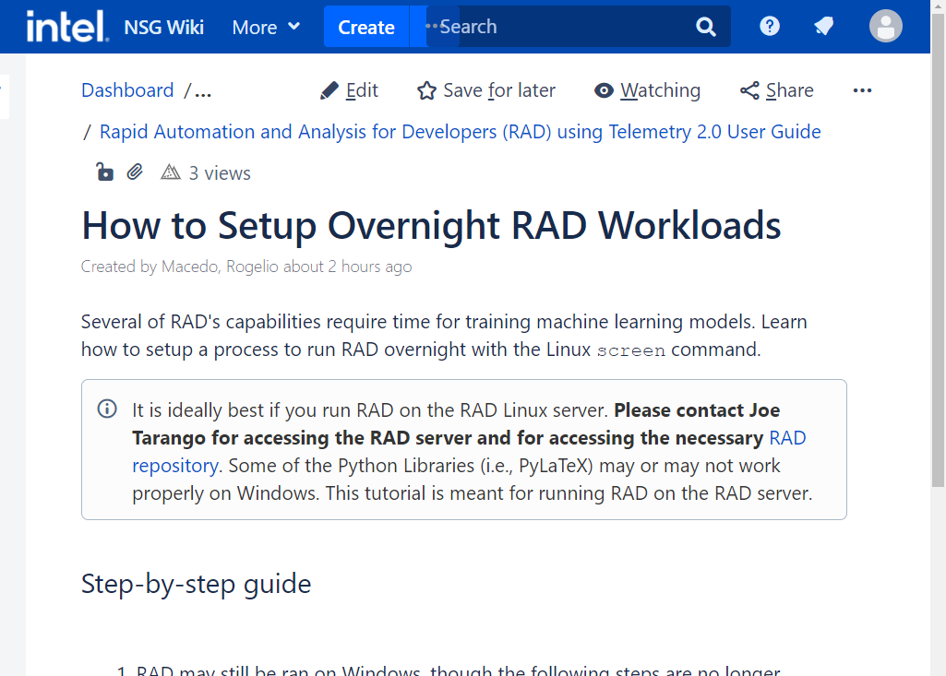
Additional Contributions Cont.
How-to Wiki to Setup RAAD to Work Overnight
Link

Slide 32
Soft Skills
Positive impact of Intel’s purpose, vision, and values
Working together towards a larger goal. Felt the importance of transparent and clear communication, meeting preparation, documentation, bringing quality work fitting our customers needs.
Overcoming confusion. Tackling problems with unclear solutions is a not uncommon in R&D. Intel’s purpose, vision, and values provide a resilient framework to thrive through together.
Defining problems, producing solutions. Practicing the scientific method day in and day out during development to clearly define a hypothesis and experiment before attempting solutions.
Notes:
For the team updates, please indicate the following:
Task – a piece of work to be done or undertaken
Goal – an aim or desired result.
Progress indicators – list of started, pending, and completed tasks
Coordination – Indicate collaboration and coordination of dependencies including integration.
Dependencies – sharing of challenges encountered.
Problems don’t have straightforward answers, particularly in R&D. Having a repertoire of tools. Being comfortable pushing what we know.

Slide 33
Technical Skills
Tools of the trade!
Debugging. What to do when getting stuck. Create the smallest test case that’s possible in which the entire behavior of the test should be expected. Incrementally make additions, and document document document!
Python Production Development. Setting up environments in Windows/Linux. Pysimplegui. Web scraping/HTTP requests under corporate proxies. Stepping through code in Pycharm. Enabling command line arguments. File IO. Unit tests. Code comparison.
Exploring Technologies and Ideas. Telemetry essentials. Inputs and outputs of collecting telemetry and metadata. Problems to solve using telemetry data (Accelerated debugging/media failure prediction).
Notes:
Let’s not disregard the paramount experience and knowledge gained regarding machine learning techniques, dealing with implementation level details, methods for embedding, neural network behavior and newly discovered problems and solutions when dealing with machine learning such as how to simultaneously train disjoint datasets with small differences of features in parallel, and techniques for merging neural networks. The mind-blowing IDFs and patents which have been recommended and shared by my teammates, and even some of the problems and Intel is working hard to solve such as machine programming, misim, control flag, autoperf, machine learning models for financial our finance team, PanteA’s LLVM Compiler Serenity plugin for persistent memory features, and so much more. The scope is phenomenal and inspiring, we are here to do the amazing and it has felt real since day 1. for that I am most grateful for.

Slide 34
THANK YOU
Notes:
THANK YOU

Slide 35


Notes:
END OF PRESENTATION

Slide 36
Appendix
Notes:
Implementation level details:
automatic file naming
Encryption of user credentials
Snippet generation
Conversion from flat dictionary to nested dictionary of dictionaries for data tokenization
Vector concatenation converting from 3D to 2D vector

Slide 37
Milestone 1: Ramping up for RAAD
values
fearless
inclusion
customer
obsessed
one intel
truth &
transparency
quality
Notes:
I first learned about Intel’s purpose, vision and values during the NEO presentation. Also, during the Quality culture training course, as well as in many other instances. I had a chance to feel them, experience them, and will take them with me everywhere I go

Slide 38
Milestone 1: Ramping up for RAAD
Same RAAD Tool, Simplified Interface
OneShotAPI (Tyler, Rogelio)
Developed GUI to initiate execution
capture telemetry/system metadata, Store/extract it in axon, parse the data, time-series extraction, feed into machine programming engine and do analysis,
Takeaway: Perform entire process with a single click, and generate expert context report
Notes:
To Simpify the entire process end to end
We want to make it easy for the fw to capture telemetry/system metadata, store/extraxt it in axon, parse the data, time-series extraxtion, feed into machine programming engine and do analysis,, lastly generate expert context report
In order to startthe process we have this simplified interface
Automatic and adjustable configurations
Enabled gathering telemetry through new interface
Developing with the customer in mind The goal was to make it easy for fw devs to use the tool, thus the tool is automatically configured to the machine in use.
The use of the RAAD tool bundles all of the output, diagrams, reports into a single location

Slide 39
Milestone 2: RAAD PF Demo
Demonstration of OneShot API gathering and processing fresh-pulled telemetry
PARSE Pre-existing Telemetry
NVMe-cli for Fresh Telemetry Pulls
Notes:
Run the oneshot in the background
Interject the description of the flow of RAAD from PF update backup slides
Why: Perform the entire flow with a single click. We want to show the ease of use
Speak about the what the differences mean:
- In one situation I am developing and implementing new features for the interface locally
- In the next I am developing remotely and testing those features with fresh pulled data
Parse: Integrating Existing Parse Functionalities into API, Allows reading payloads at the UID level, returns dynamically, Cross-team integration
NVMe-cli: Enables dependency from TWIDL in an easy-to-use Python format, Allows reading payloads at the UID level, returns dynamically, Cached implementation for fast reads

Slide 40
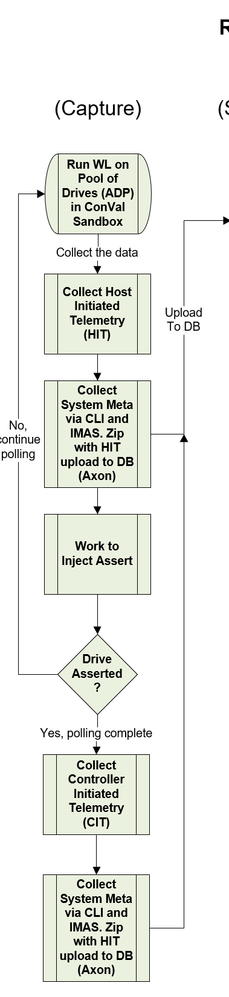
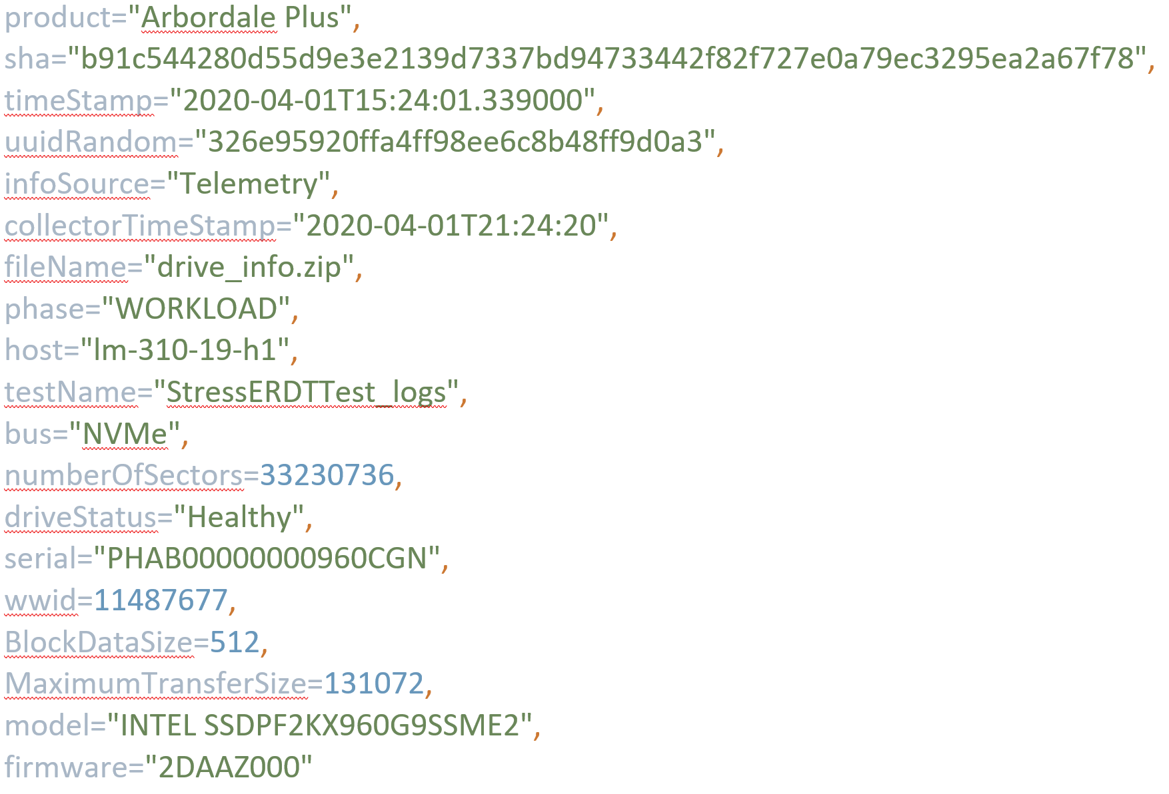
RAAD Framework flow: capture
RAAD_Pool drives set up in ConVal sandbox [Daniel, Joe]
Precondition SSD with IOMeter and FIO workload
Periodic Pull of Host Initiated Telemetry (HIT) [Daniel, Joe]
ML Auto Tuning of Data Pull Frequency, pre-process, and time series
Inject Test Command Errors for Controlled Experiments
Telemetry and Media Meta Collection Scripts [DND–Josh Yang, Daniel, Joe]
Collect System Meta Data [Tyler, Daniel, Joe, DND-Amir]
Collect Data from NVMe ID Controller, CLI, and IMAS to assemble meta data
The System Data Captured (shown in box to the right)
Upload to Axon DB [Tyler, Joe, Amir, and Dawson]
Zip and upload Telemetry binary and System Meta
Note: In the future, capture will include ConVal, PV, Customer, etc.
Notes:
Under the capture flow, capture HIT in which the drive is performing fine, or we could capture controller intiated telemetry in which there’s issues in the drive. In our PF example, we induced an assert DF049 which is a wear-leveling issue. This in turn allows us to capture controller initiated

Slide 41
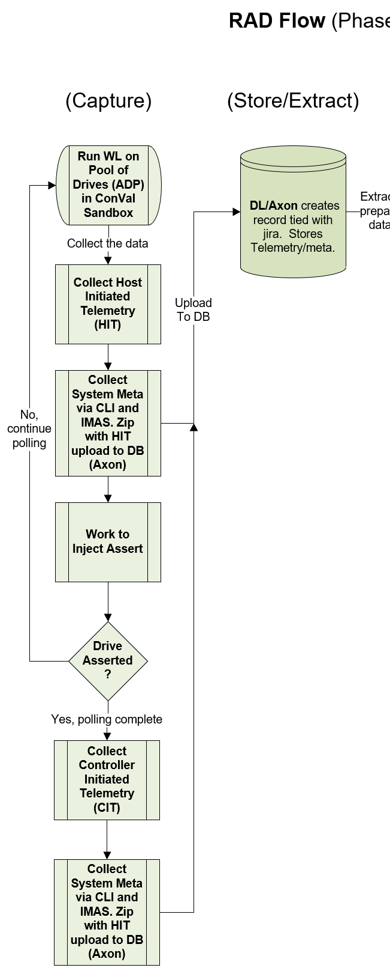
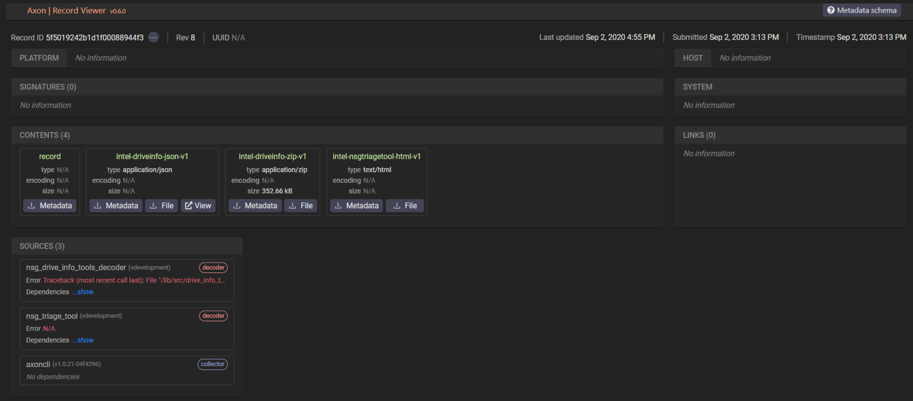
RAAD Framework flow: store/extract
Axon Store (Tyler and Amir)
Axon Extract to Cloud (Tyler and Amir)
Command
Data
Notes:
Store and Extract

Slide 42
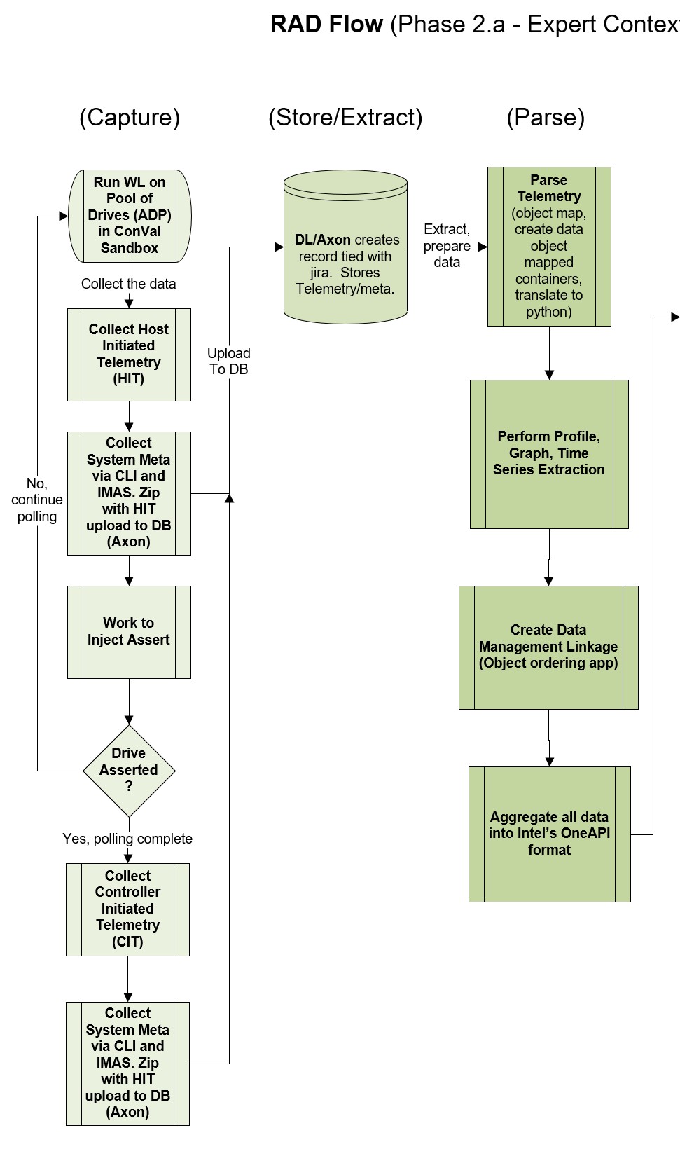
RAAD Framework flow: Parse
Parse Telemetry Binary (CFE-Phuong and Joe)
New compiler features (similarity search and verified lifting of meta data)
Python 2.x and 3.x compatible
All data objects can be parsed
Details upon request
Time Series Visualization (Daniel)
Preconfigured / Dynamic Guided Graph Generation
Details in backup (for offline discussions)
Data Management Linkage (Joe/Daniel)
Developed a time series file format
Data Aggregation into OneAPI (Joe/Daniel)
Transform the file format into TensorFlow objects, using multiple embedding

Slide 43
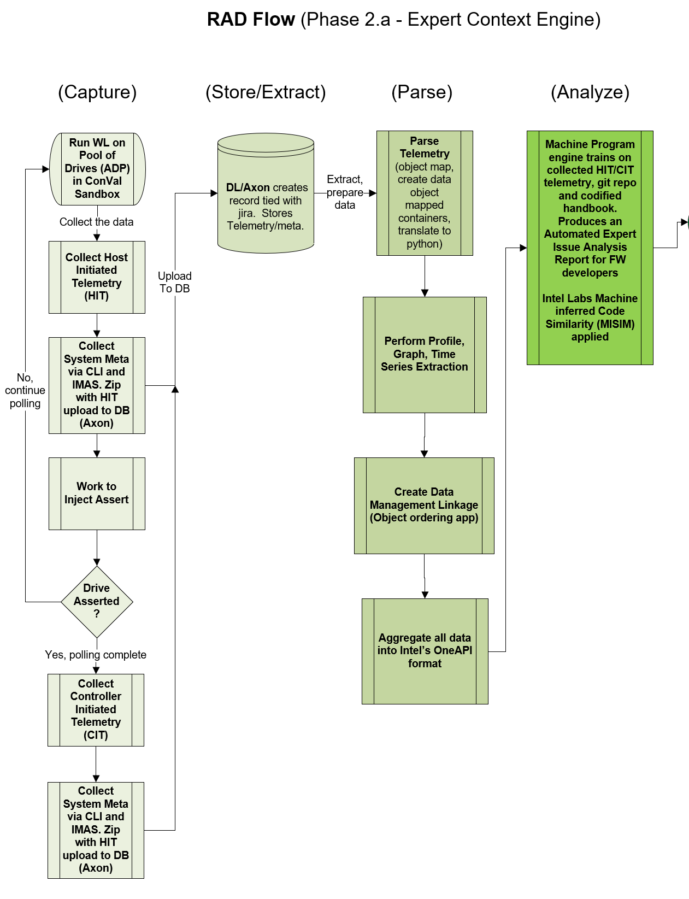
RAAD Framework flow: Analyze
Codified Debug Handbook info (Joe and Amir)
DF049 - The failure is a result of a long-term algorithmic issue with our core algorithms for band selection and data relocation.
Machine Learning Algorithms (Joe and IL-Justin)
Using data mining techniques to feed the search and match algos
Details upon request
Generate the RAAD Expert Context Report
Have a Python API that will generate all the content
BONUS Machine Inferred Code Similarity - MISIM (IL-Justin, Stanley and Fangke)
Code similarity is concerned with if two code snippets are semantically similar (i.e., having similar characteristics through some analysis)
Has been run on NSG’s FW code repo
Used >7000 code pushes to fix bugs as golden snippets Details in backup

Slide 44
RAAD Framework flow: codified Debug HAndbook
Debug Handbook wiki
(DF - Defrag Asserts)
Codified handbook (DF049)
Codified handbook (DF049)

Slide 45
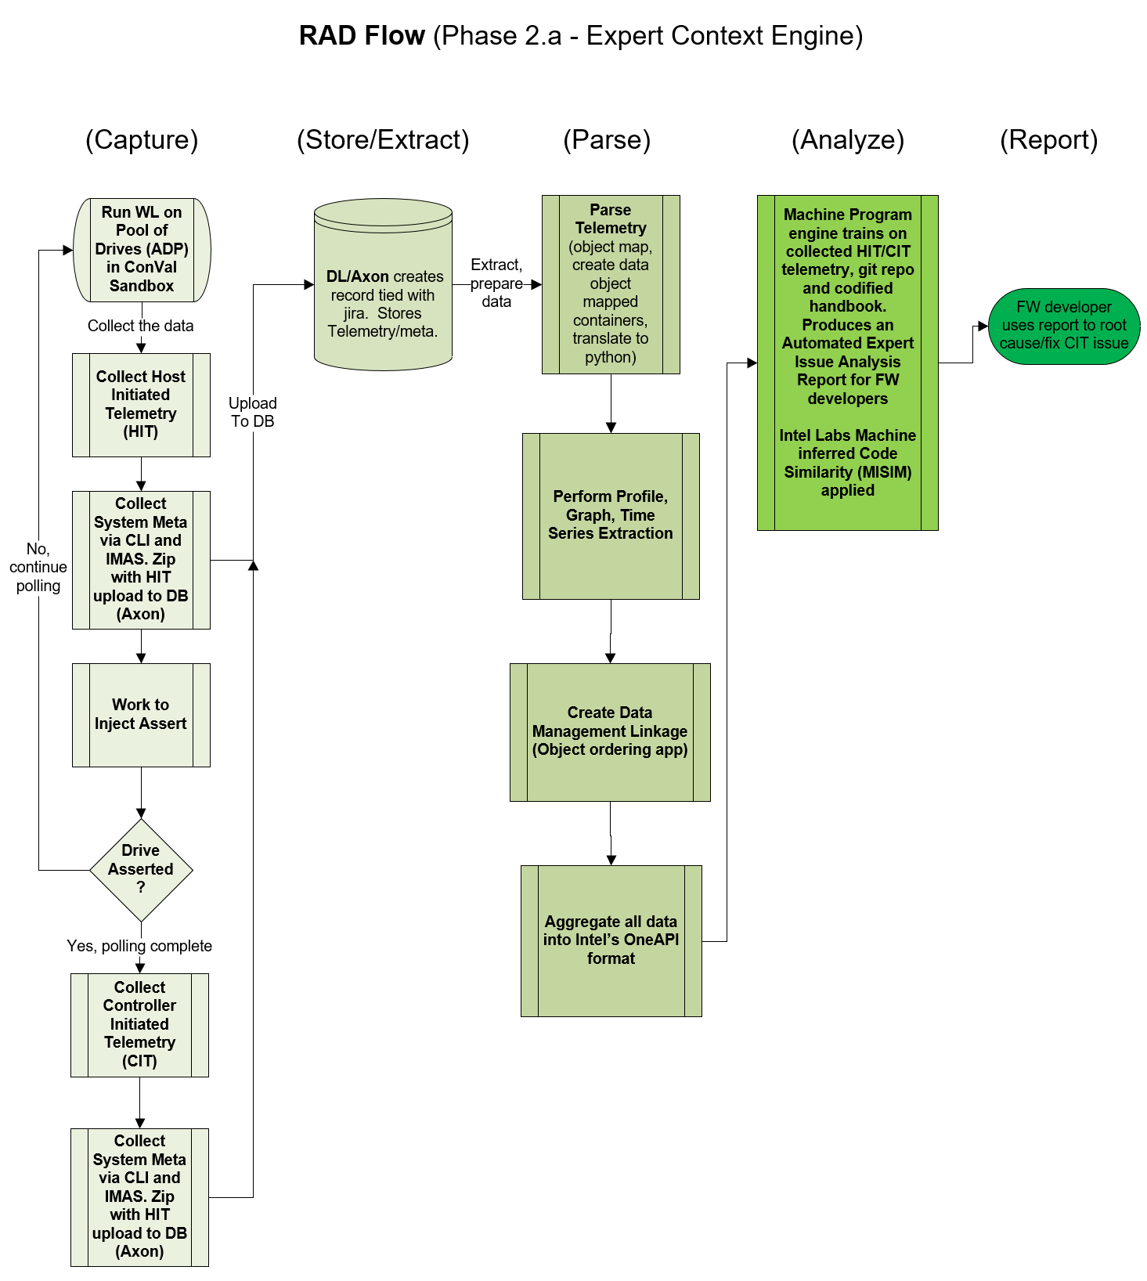
RAAD Framework flow: Report
RAAD Expert Context Report
See content produced by demo
Plan to compare the RAAD report versus an expert’s input for DF049 in Q4

Slide 46
Results
Input validation: verifying that the input passed to the framework will produce feasible results

Slide 47
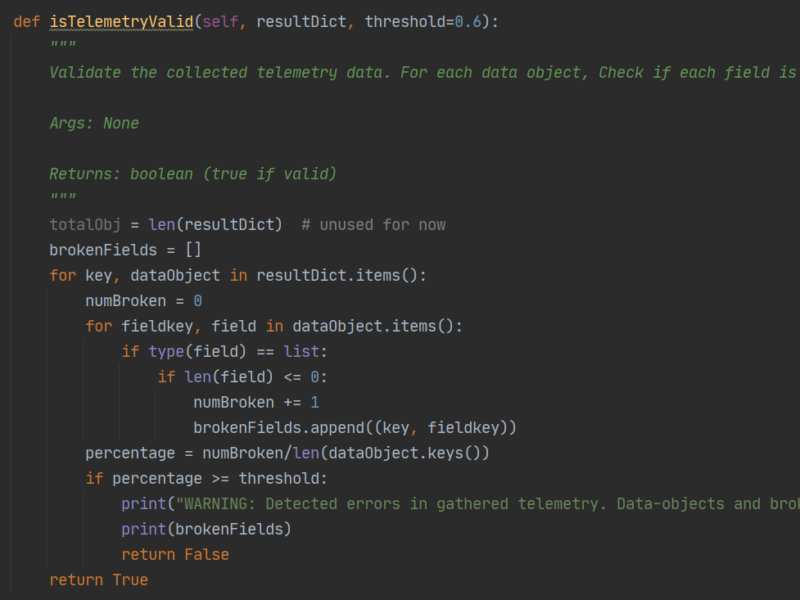
Results
Output Validation: Verifying the quality of the expected results/content produced

Slide 48
Milestone 3: JIRA Autolabeling
What are we doing?
Creating an automated recommendation system for developers in which it uses JIRAs to learn from the past and help add structure to things (i.e., a recommendation system of bug information).
Why would we want such a system?
Learn to replicate the behavior of the best advice-givers
Guide humans through bugs and potentially make suggestions on root causes
Automatically fill blanks in data
Detect similarity between JIRAs/telemetry payloads
Predict the final state of a JIRA (i.e., what it will look like when it gets closed)
Our assistance with validation of outputs can allow the system to potentially help produce better recommendations than humans!
Notes:
Python2 to Python3
Connection and crawling of Jiras
Crawl for information regarding DF-049, MBO-002, wear-leveling, transport mailbox issues
Organizing Jira data
Lossless compression of text data
Why we doing this
Want AI system to learn from the past
Want AI system to learn who are best ppl at giving advice and replicate behavior/give reccomendations (recommendation system of bug info)
Reccomendation system for developers, helping guide with bugs, and potential to suggest root cause
Train it to talk to humans and help fill in blanks in data
What will the JIRA look like by the end of it when it gets closed?
Goal of system (in terms of misim compiler) want recc. Systems for the outcomes
Misim creates syntax tree similar to jira tree. In each tree layer it has fields (i.e. label=‘’, label_output=‘’, etc)
Add structure to things humans know nothing about.
Want to be able to input something new and have it produce some useful results
Human assistant system, but eventually AI should do figure out what to recommend
Teach NN consumes all these JIRAs and see what it produces. Want a system acting as human interactive AI
Feed output into smaller NN outputs giving spec. types of results, telling you what’s going on
By us helping train with validation of outputs, it can potentially help produce better recommendations than humans

Slide 49
Preliminary Results: Data Processing
Collected/Cleaned ~400 JIRAs pertinent to DF049
Create crawler just for DF049 which organizes related JIRA information
Pre-processes crawled data
Cleaning/removing noise in data, and stores it all in a database (locally stored as of now)
What is to come
Lossless compression of text data (symbols, words, phrases) using Huffman Encoding
Machine learning/similarity search on compressed data finding similarity between crawled JIRAs and telemetry payloads

Slide 50



Soft Skills
Positive impact of Intel’s purpose, vision, and values
Working together towards a larger goal. Felt the importance of transparent and clear communication, meeting preparation, documentation, bringing quality work fitting our customers needs.
Overcoming confusion. Tackling problems with unclear solutions is a not uncommon in R&D. Intel’s purpose, vision, and values provide a resilient framework to thrive through together.
Defining problems, producing solutions. Use of the scientific method during development to clearly define a hypothesis and experiment before attempting solutions.
Notes:
For the team updates, please indicate the following:
Task – a piece of work to be done or undertaken
Goal – an aim or desired result.
Progress indicators – list of started, pending, and completed tasks
Coordination – Indicate collaboration and coordination of dependencies including integration.
Dependencies – sharing of challenges encountered.
Problems don’t have straightforward answers, particularly in R&D. Having a repertoire of tools. Being comfortable pushing what we know.

Slide 51
Technical Skills
Tools of the trade!
Debugging. What to do when getting stuck. Create the smallest test case that’s possible in which the entire behavior of the test should be expected. Incrementally make additions, and document document document!
Python Production Development. Setting up environments in Windows/Linux. Pysimplegui. Web scraping/HTTP requests under corporate proxies. Stepping through code in Pycharm. Enabling command line arguments. File IO. Unit tests. Code comparison.
Exploring Technologies and Ideas. Telemetry fundamentals. Inputs and outputs of collecting telemetry and metadata. Problems to solve using telemetry data (Accelerated debugging/media failure prediction).

Slide 52
RECOGNITIONS
Special Recognition
Intern Mentor:
Joe Tarango,
Manager:
Jim Baca,
GM:
Sanjeev Trika
Teammates:
Tyler Woods,
Daniel Garces,
PanteA Zardoshti

